Slide 1
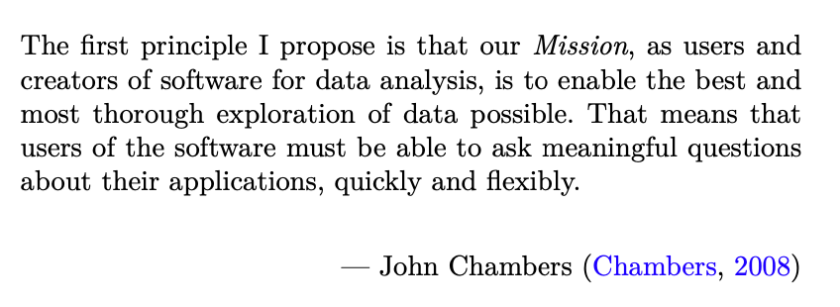
Data Science for Operational Researchers using R
01 - Introduction
https://github.com/JimDuggan/Data-Science-for-OR

Slide 2
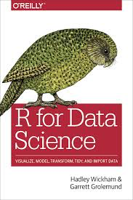
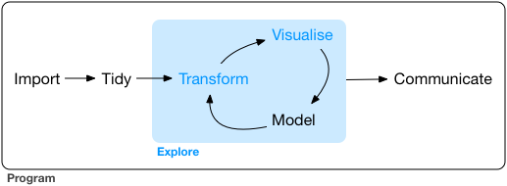
Goal
Improve your personal productivity for generating rapid and insightful results from large data sets.
Learn about the role of R in the overall data science life process.
Appreciate the power of R and the 'tidyverse' set of packages for increasing productivity
https://r4ds.had.co.nz

Slide 3

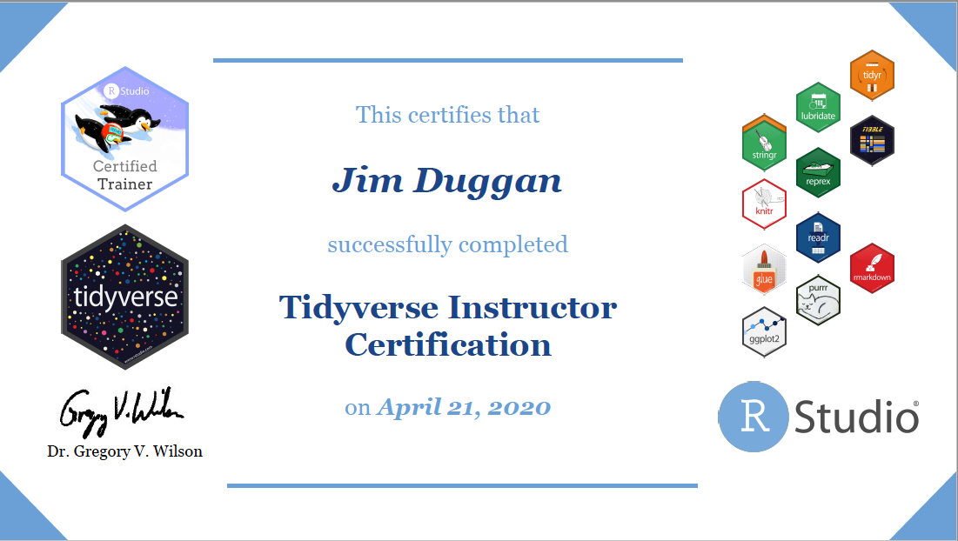
Instructor –Jim Duggan
Lectures in
Programming (R, MATLAB),
Modelling & Simulation
Research interests:
System Dynamics
Computational Epidemiology
Data Science
https://education.rstudio.com/trainers/people/duggan+jim/
https://twitter.com/_jimduggan

Slide 4
Course Overview
Topic | Description
 | Morning 1
1 | Introduction to R and Posit Cloud
2 | Atomic Vectors
3 | Functions, Lists and Functionals
4 | Data Frames and Tibble
5 | ggplot2
 | Morning 2
6 | Data transformation with dplyr
7 | Relational Data with dplyr
8 | OR Example 1 – Exploratory Data Analysis
9 | OR Example 2 – System Dynamics

Slide 5
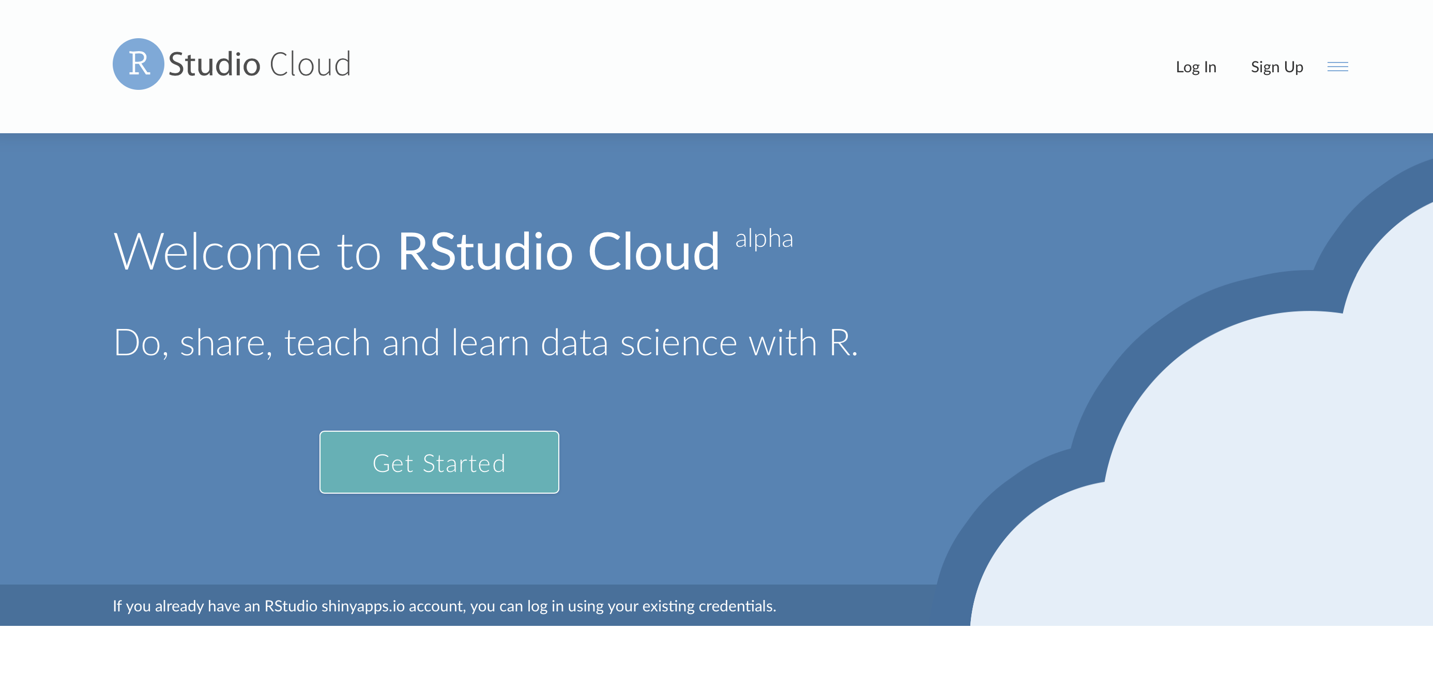
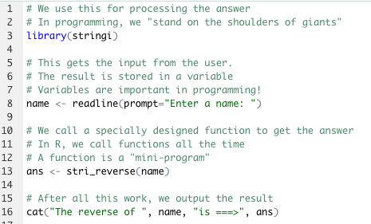
The R Project for Statistical Computing
R’s mission is to enable the best and most thorough exploration of data possible (Chambers 2008).
It is a dialect of the S language, developed at Bell Laboratories
ACM noted that S “will forever alter the way people analyze, visualize, and manipulate data”

Slide 6
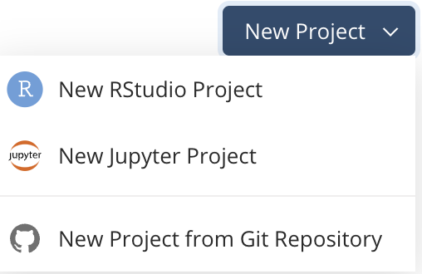
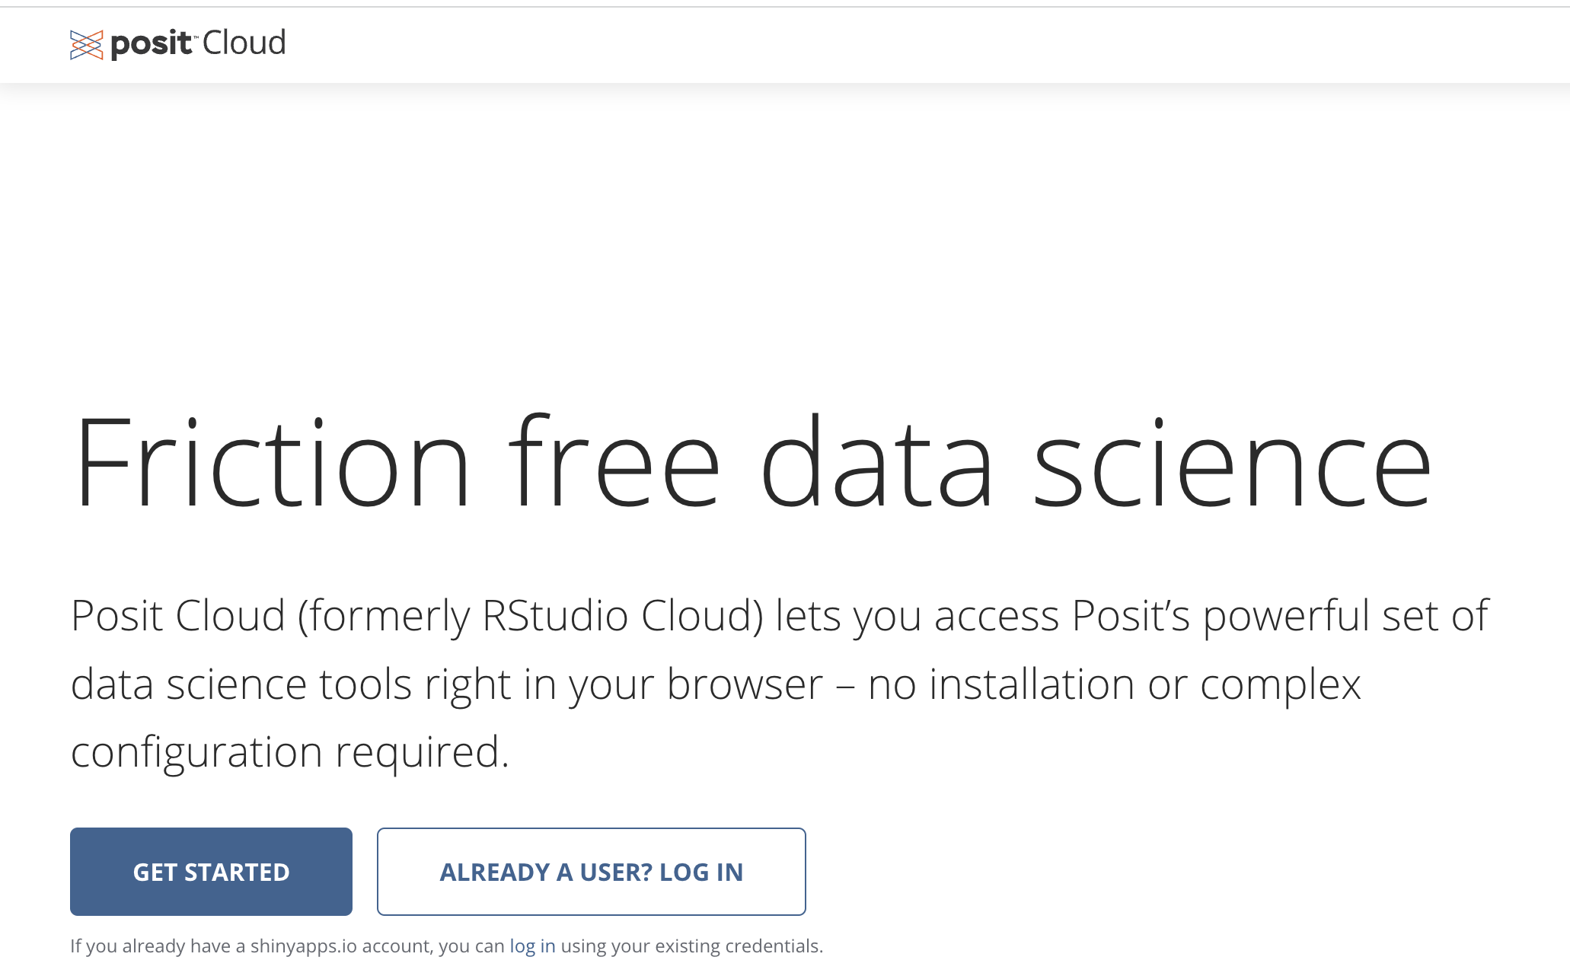
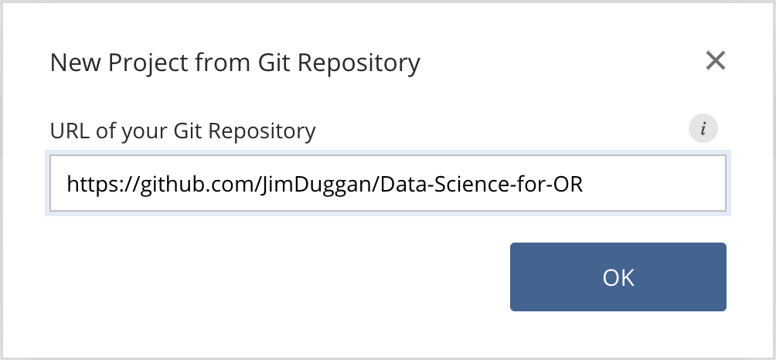
First Steps: Posit Cloud – Create Your Account

Slide 7
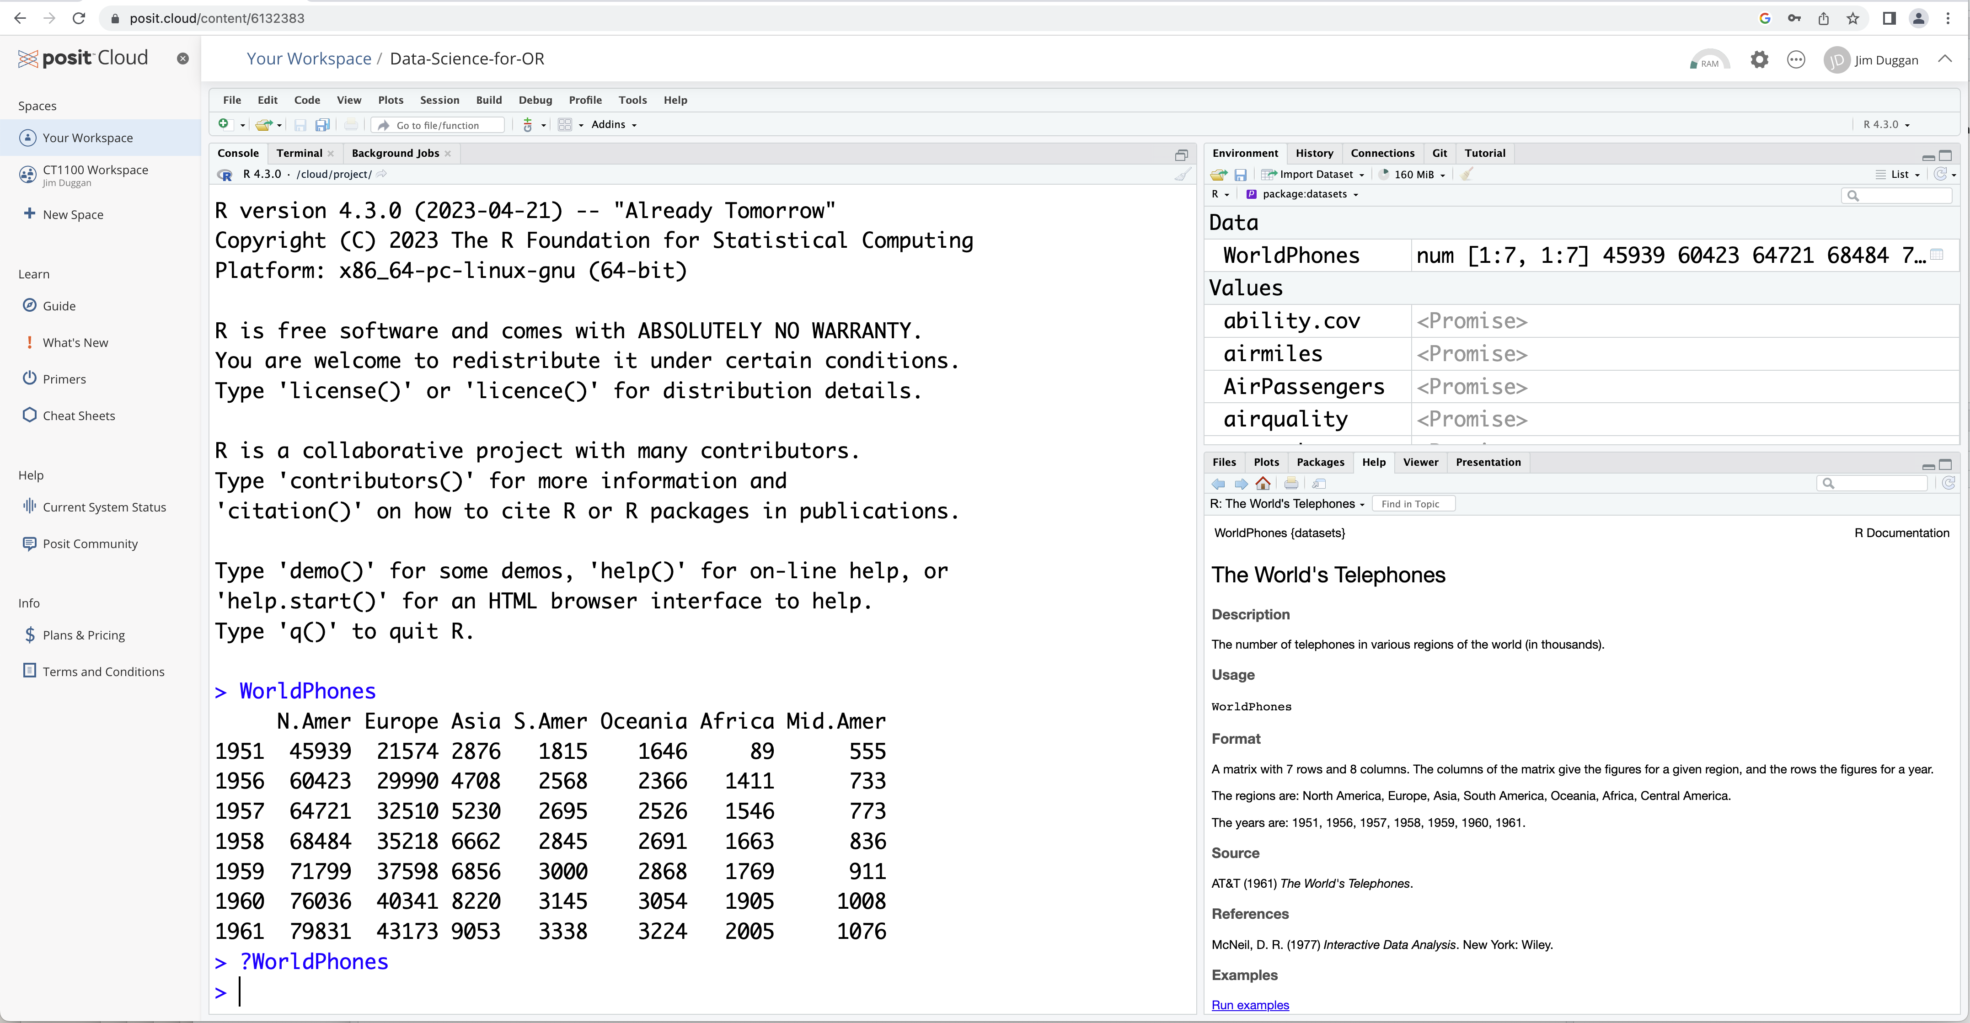
View the R IDE

Slide 8
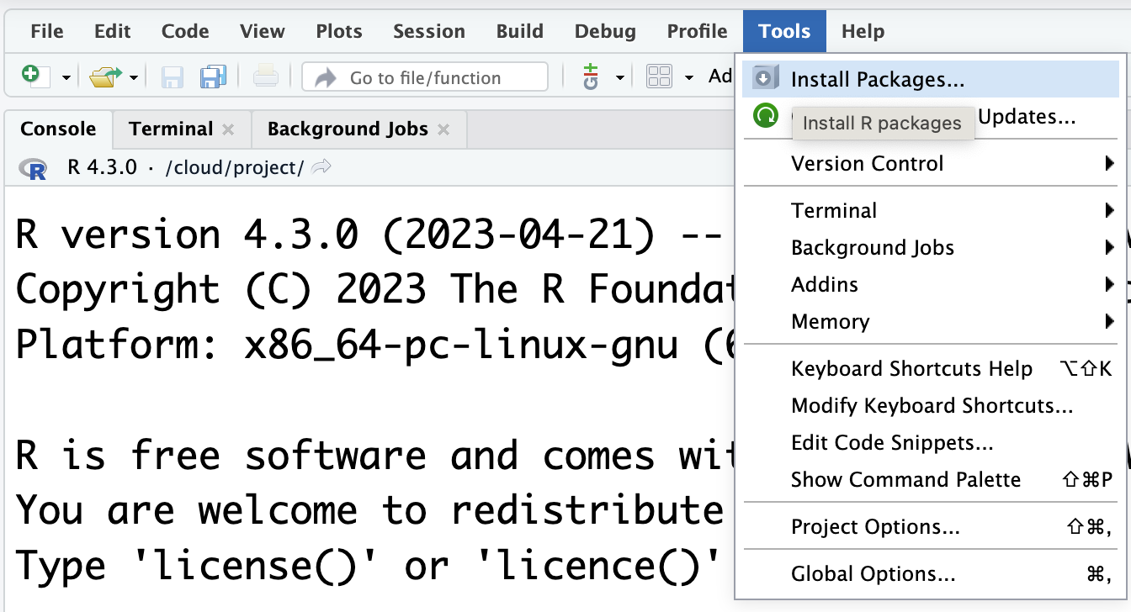
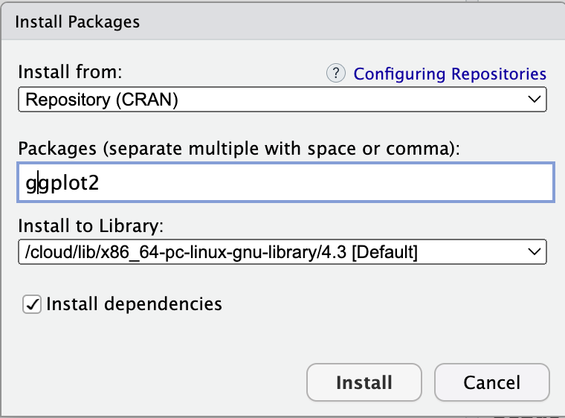
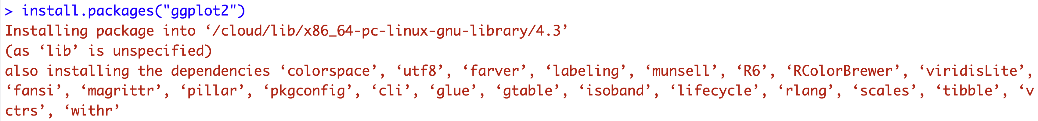
(5) Install packages…

Slide 9
(7) Packages required
Package | Purpose
ggplot2 | Produce graphics for data
dplyr | Analysis of data held in tibbles/data frames
aimsir17 | 2017 Weather data for Ireland
purrr | To iterate over data structures
tidyr | To tidy rectangular data, and to nest data sets

